Slide 1


A semi-supervised generative framework with deep learning features for high resolution remote sensing image scene classification
Ruyi Feng, Wei Han(PhD candidate), Lizhe Wang
Oct. 30, 2019
School of Computer Science
Hubei Key Laboratory of Intelligent Geo-information Processing
China University of Geosciences (Wuhan)
Notes:
ISPRS Journal of Photogrammetry and Remote Sensing
Volume 145, Part A, November 2018, Pages 23-43

Slide 2
Outlines
Background
Semi-supervised generative framework with deep learning features (SSGF)
HRRS scene classification based on SSGF
Experiment and analysis
Conclusion

Slide 3
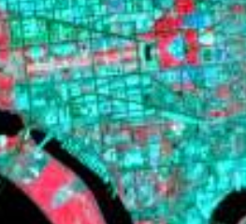
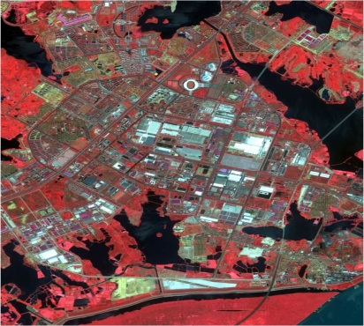
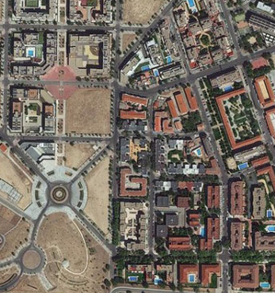
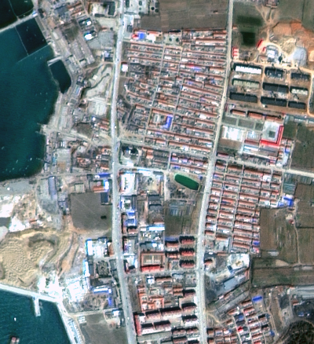
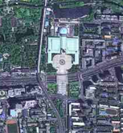

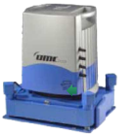

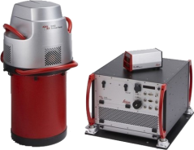
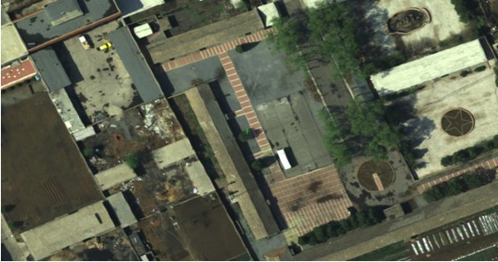
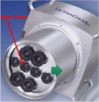

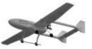
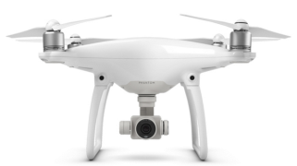
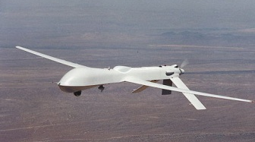
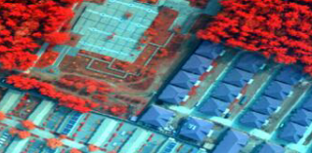
1. Background
Landsat 1
(78-30m)
IKONOS
(1-4m)
Worldview-3
(0.31-1.2m)
ZY-3, 2012.1
(2.1-5.8m)
GF-2, 2014.8
(1-4m)
Satellite
DMC
UCD
SWDC4
ADS80
Aerial camera
UAV
DJ-UAV
UAV-cm level

Slide 4
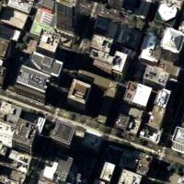
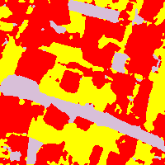
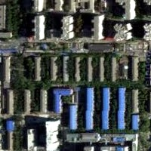
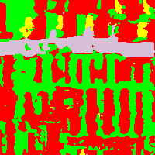
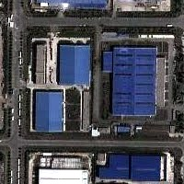
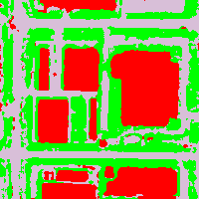
1. Background
HRRS Image
Object-Level
Semantic Information
commercial area
Residential
Object detection
Scene classification
Industrial
Semantic Gap

Slide 5
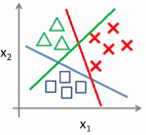
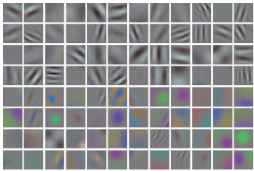
1. Background
The basic flowchart for Scene classification
commercial area
^{HRRS images}
^{features}
^{classifier}
^{assign a semantic level tag}
Feature representation plays a crucial role
in high performance classification methods!
Notes:
Since scene classification is generally effected by feature maps, effective feature representation plays a crucial role in high performance classification methods.

Slide 6
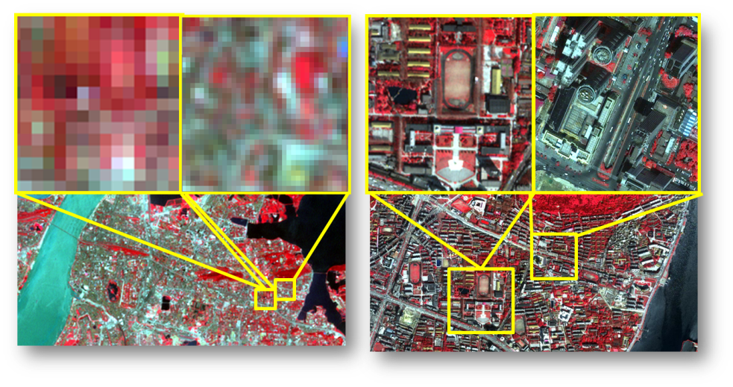
1. Background
Challenges from improved image resolution：
AlexNet
Clarifai
GoogleNet
ResNet
15.32
11.20
Top 5 Error
Rate(%)
6.66
3.57
2012
2013
2014
2015
Year
30 meter spatial resolution
2.4 meter spatial
resolution
2012-2015 ImageNet Image
Classification Error Rate
objects show more details；
a large number kinds of objects;
complex spatial patterns.
Deep learning model has achieved great success in natural image classification.
Notes:
Traditional handcrafted-feature-based methods and unsupervised-feature-learning methods can not meet the requirements of the HRRS image scene classification.

Slide 7
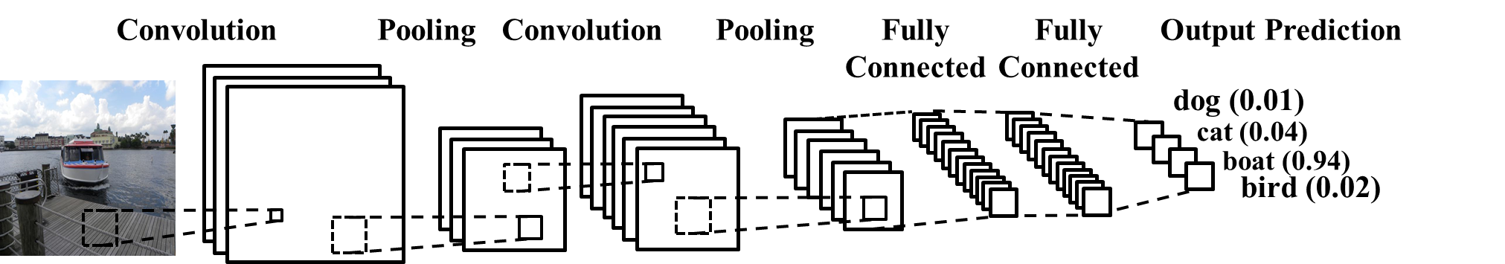
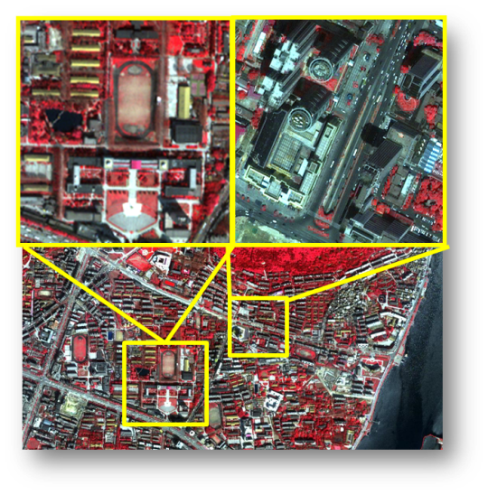
1. Background
Classical CNN framework：
Adopt
Deep learning model:
Automatically extracting hierarchical features;
Processing massive samples;
Reducing manual labor.
Extensive annotation!
Scene classification
Object Detection

Slide 8
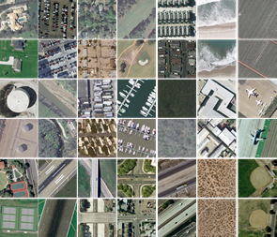
1. Background
The supervised methods have faced a severe challenge that a great number of manually annotated HRRS samples are required to obtain a reliable model.
6750 times
less
14,000,000 images
2,100 images
ImageNet dataset
UCM dataset
Dataset | Class and image number
AID | 30 classes, 10,000 images
NWPU-RESISC45 | 45 classes, 31,500 images
PatternNet | 38 classes, 30,400 images
RSD46-WHU | 46 classes, 117,000 images
The sizes of the remote sensing datasets are significantly smaller than natural image dataset.

Slide 9
How to address the problem of lacking annotated data?
A semi-supervised Generative Framework for remote sensing scene classification (SSGF) is proposed to train an ideal classification model to cope with the small sample problem:
deep learning feature based self-label technique;
a co-training based self-label method;
a discriminative evaluation method for distinguishing confusion classes.

Slide 10
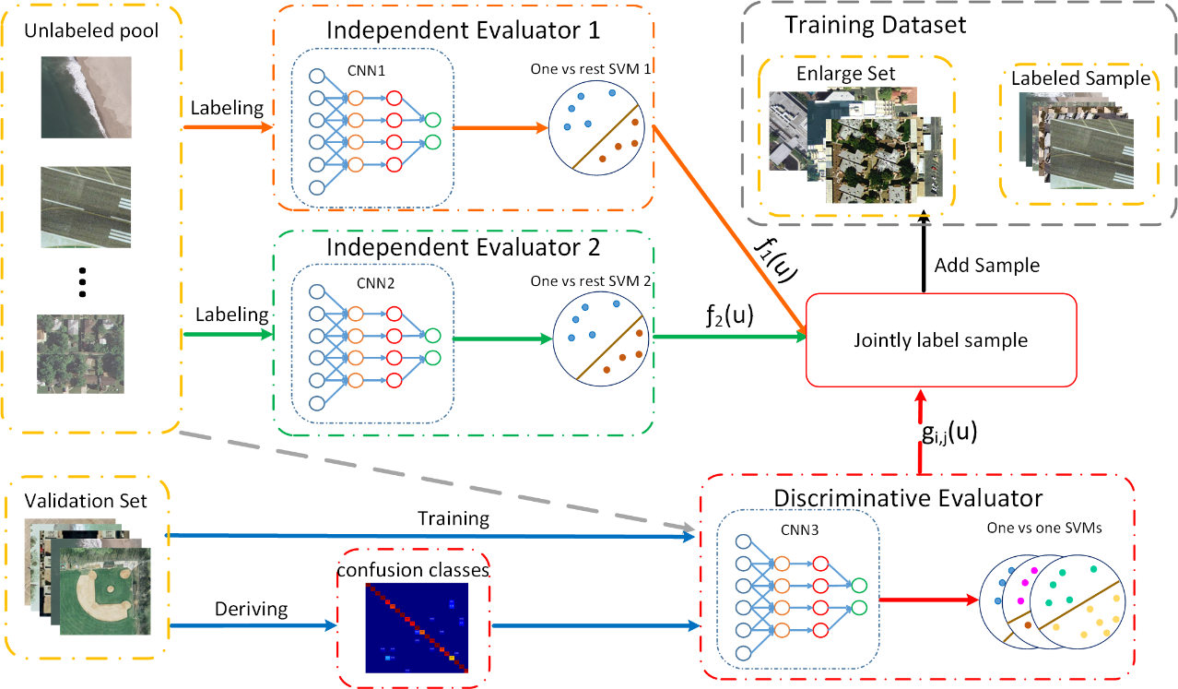
Pipeline of SSGF

Slide 11
2. Semi-supervised Generative Framework
Deep learning feature based self-label method
Labeling
Model labels the samples.
Training
Training the model with Labeled samples.
Initializing
pretrained CNN as feature extractor，SVM as classifier
Illustration of
1. Deep learning feature based self label technique

Slide 12
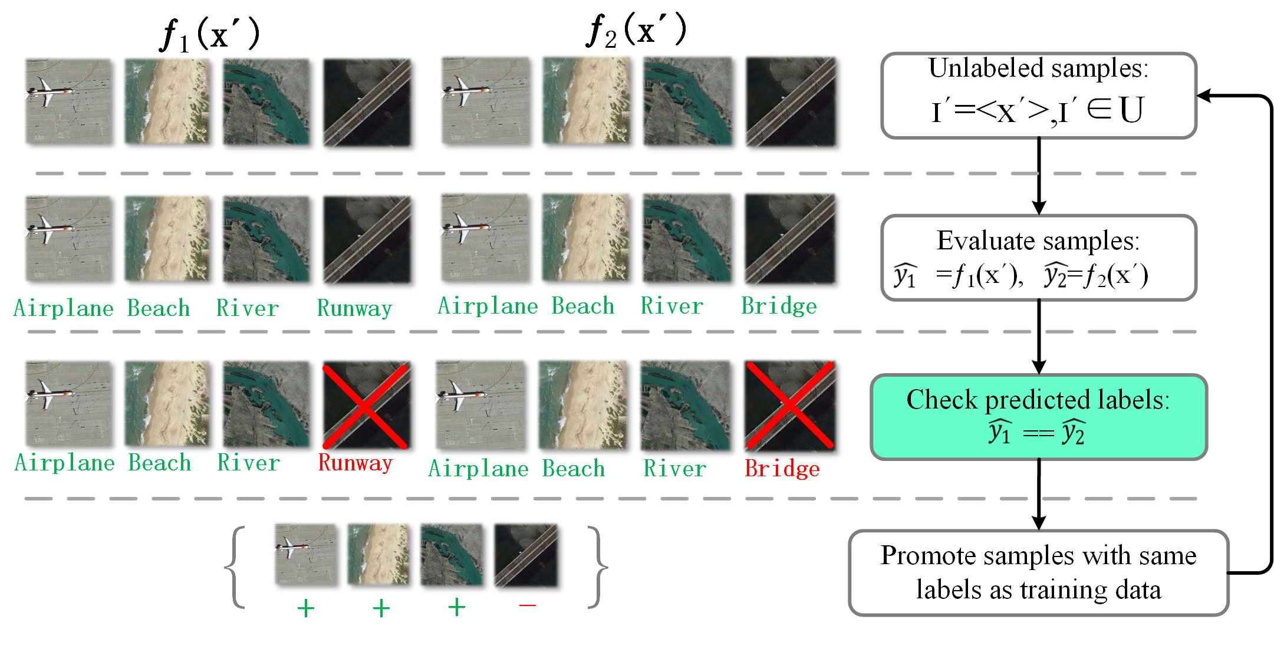
2. Semi-supervised Generative Framework
A co-training based self-label method
2. Co-training based self-label method

Slide 13
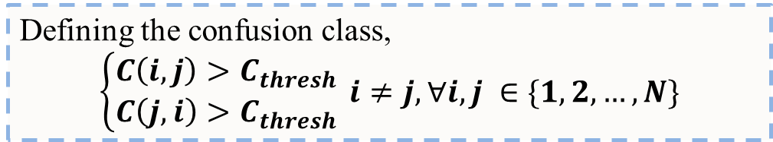
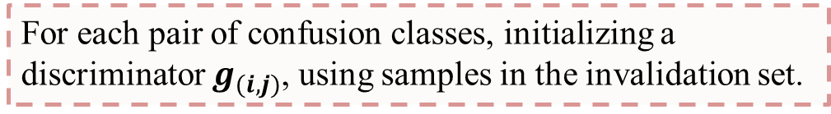

2. Semi-supervised Generative Framework
Defining the confusion class
Initialize discriminators
Label
3. A discriminative evaluation for distinguishing confusion classes

Slide 14
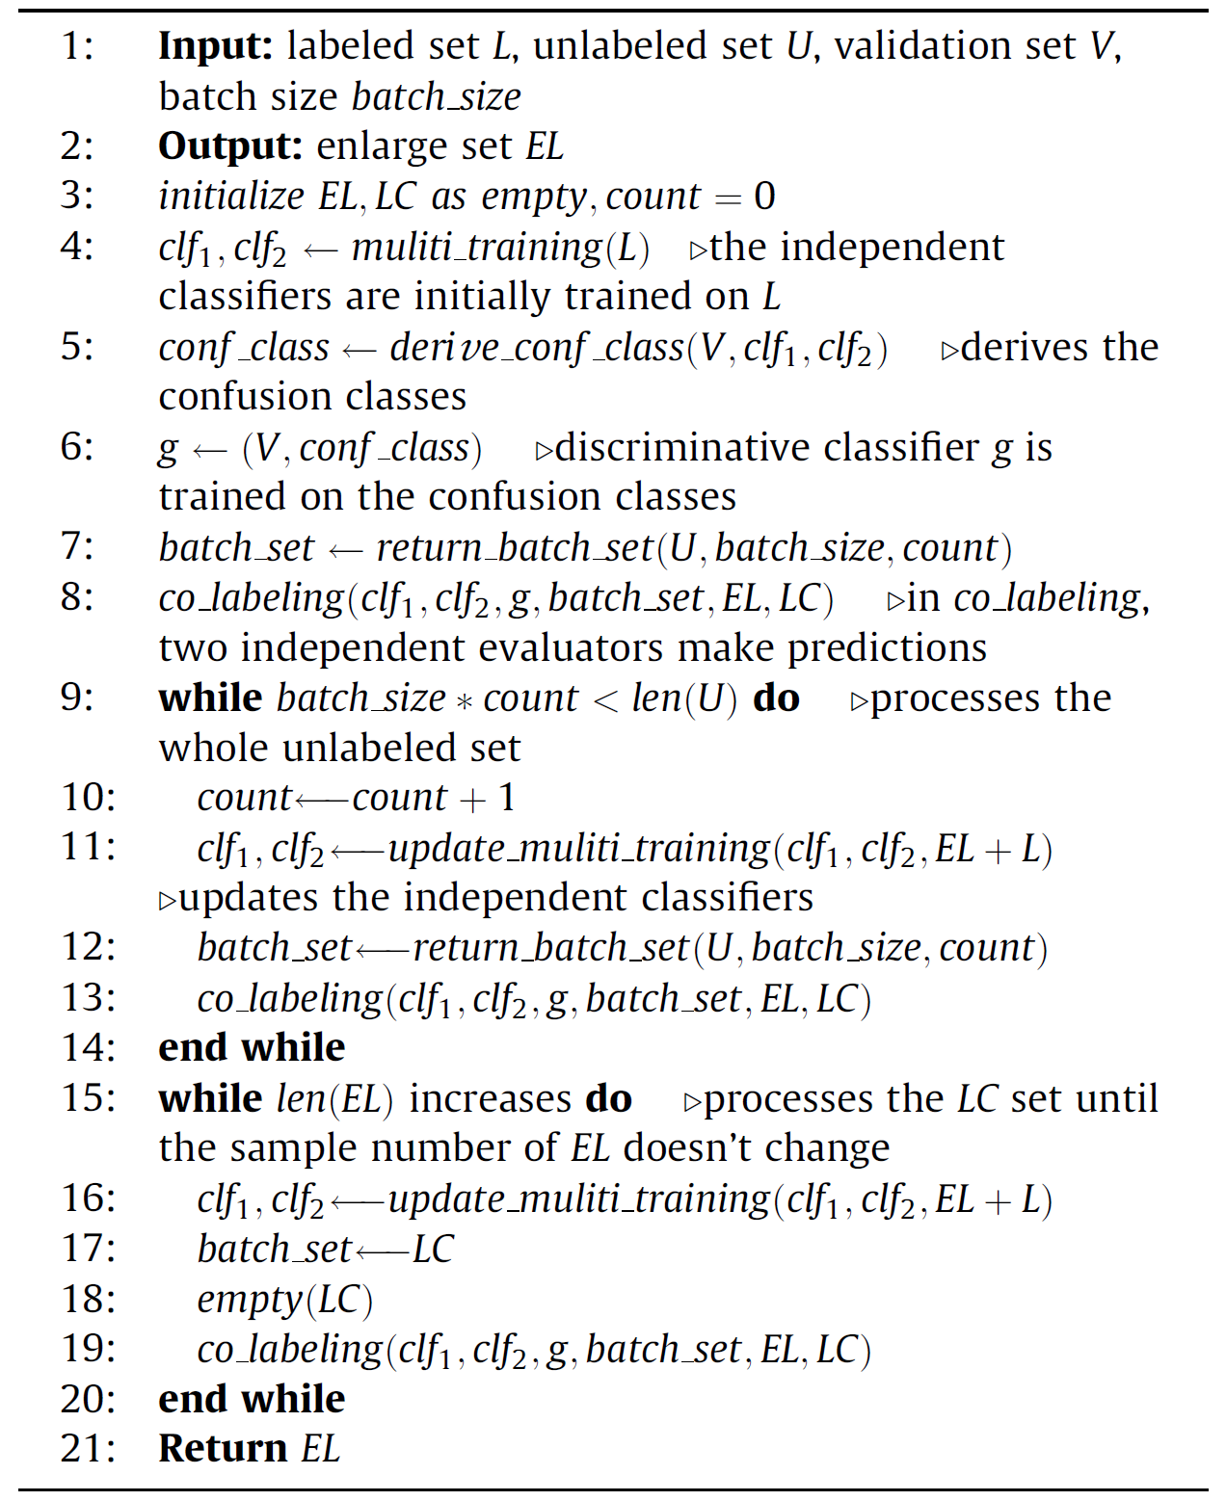
3. HRRS scene classification based on SSGF
Initialize the independent evaluator and the discriminator
Iterative labeled samples
The overall framework
A co-training evaluator and a discriminator
The co-training evaluator: VGG-S and ResNet-50
The discriminator: VGG16
The Overall Algorithm

Slide 15
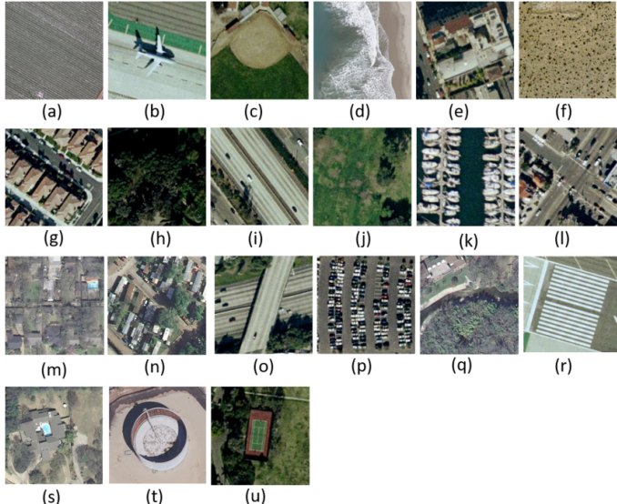
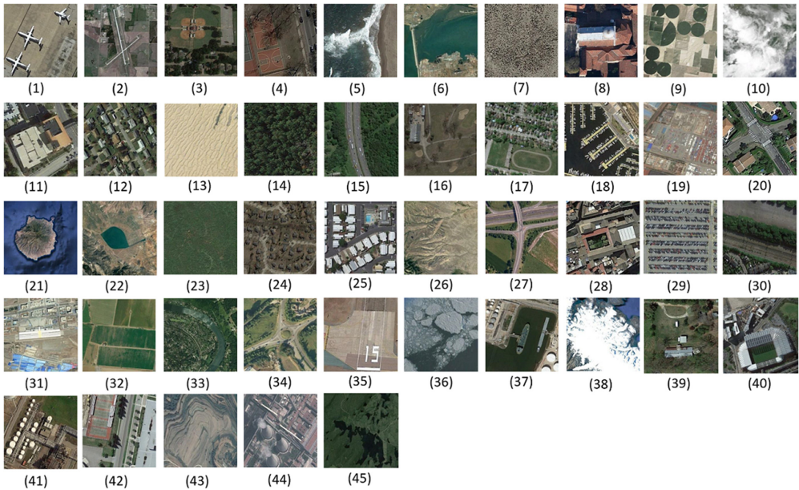
4. Experiments and Analysis
Dataset：UC Merced dataset
Source：USGS
Spatial Resolution：1ft
Number of image：2100
Number of class：21
Number of each class：100
Dataset：NWPU RESISC45 dataset
Source：Google Earth
Spatial Resolution：0.2m-30m
Number of image：31,500
Number of class：45
Number of each class：700

Slide 16
4. Experiments and Analysis
Datasets Segmentation Settings
Training Dataset ratio |  | Validation | Test
Labeled | Unlabeled | 20% | 20%
10% | 50%
Comparison methods:
CaffeNet, VGG-F, VGG-S, VGG-M, VGG-16, VGG-19, ResNet-50.
Comparison methods used the manner of supervised training.

Slide 17
Experimental Results on UCM dataset
Comparison of classification accuracies
Classification accuracy curve
Confusion Matrix on UCM dataset (94.52%)

Slide 18
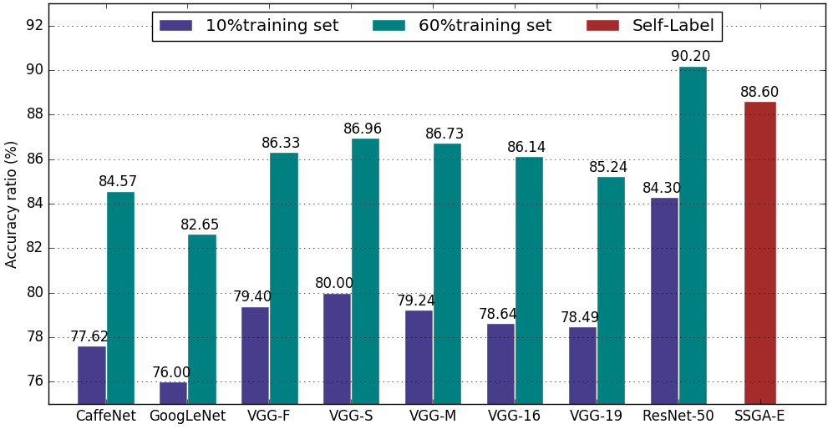
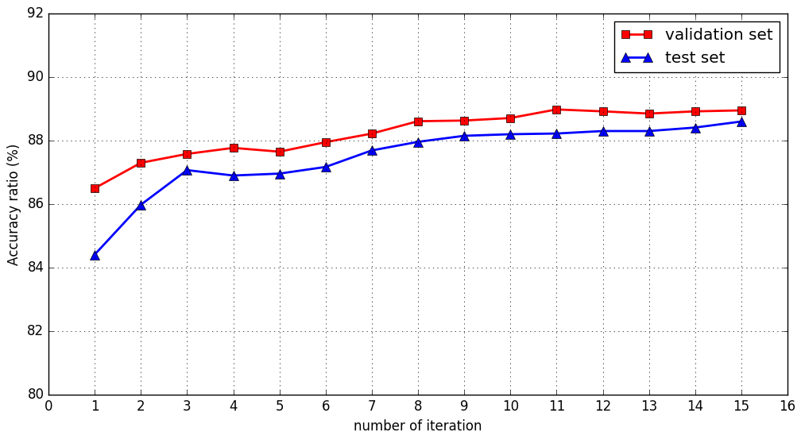
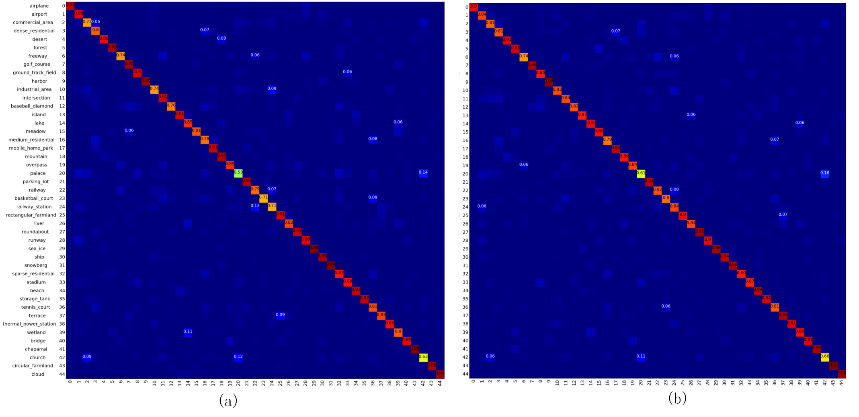
Experimental Results on NWPU45
Comparison of classification accuracies
Classification accuracy curve
Confusion Matrix on NWPU45dataset (94.52%)

Slide 19
4. Experiments and Analysis
Classification accuracy , OA(%)
Datasets | UCM | NUPW-RESISC45
CaffeNet | 93.9 | 84.57
VGG-F | 94.14 | 86.33
VGG-S | 94.85 | 86.96
VGG-M | 93.95 | 86.73
VGG-16 | 94.09 | 86.14
VGG-19 | 93.65 | 85.24
ResNet-50 | 95.52 | 90.2
Co-training | 93.75 | 87.25
Proposed Method | 94.52 | 88.86

Slide 20
5. Conclusion
Focusing on the problem of insufficient manually-labeled samples, we proposed a semi-supervised generative framework:
deep-learning-based feature
the co-training based self label method
the discriminative evaluator
The framework goes along with a limited annotation samples and extensive unlabeled samples for reliable annotation datasets for scene classification.

Slide 21
Thank you for your attention!

